Slide 1


Capstone Project
Author: Ahmed Mahamid
Supervisor: Prof.Zeev Barzily
www.fithub.com
01

Slide 2



Sport club
FITHUB
www.fithub.com
02

Slide 3


FITHUB
CONTENT
introduction
problems
solution
Features
product
Verification
requirements
challenges
03

Slide 4

FITHUB
INTRODUCTION
My sports club management system helps to manage club operations with its user-friendly platform. Members can easily register for courses and manage appointments, while instructors and administrators benefit from streamlined course and instructor management. Enhance your club experience with our all-in-one solution.
04

Slide 5


FITHUB
PROBLEMS
POOR COMMUNICATION WITH MEMBERS
LACK OF MARKETING OPPORTUNITIES:
Difficulty effectively communicating with members, leading to decreased participation and member churn.
Difficulty reaching a new audience and attracting new members.
DATA MANAGEMENT CHALLENGES:
POOR CUSTOMER SERVICE:
Difficulty tracking member data, such as contact information, payment details, and attendance records.
Difficulty responding to member inquiries and providing technical support.
05

Slide 6
FITHUB
SOLUTION
WEBSITE:
CRM MANAGEMENT SYSTEM:
Effective communication platform to interact with members.
Primary marketing channel to attract new members.
Tool for providing excellent customer service.
Automate repetitive tasks to save time and resources.
Analyze member behavior data and preferences.
Reduce operational costs and improve efficiency.
06

Slide 7
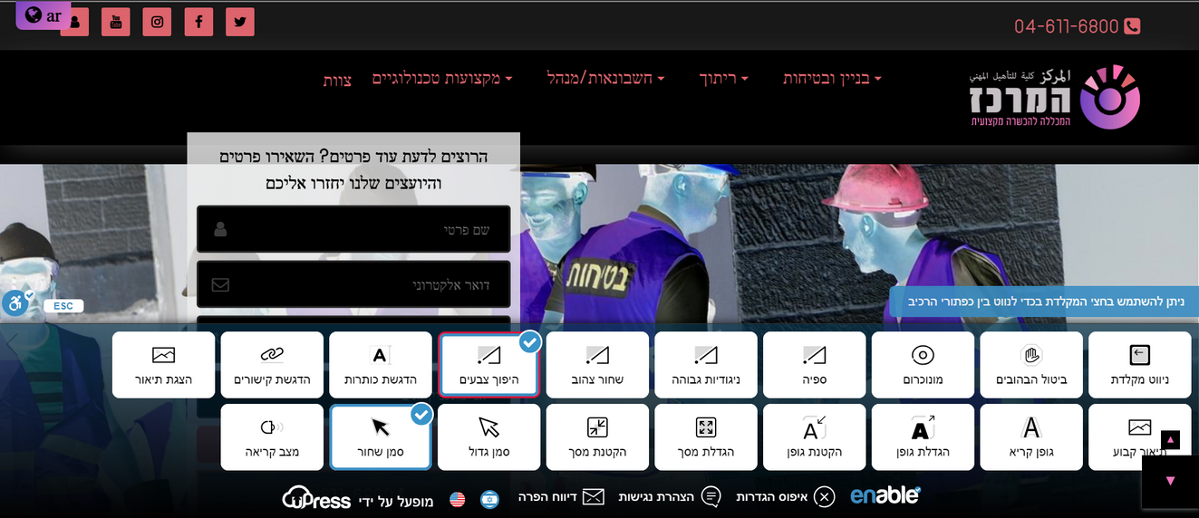
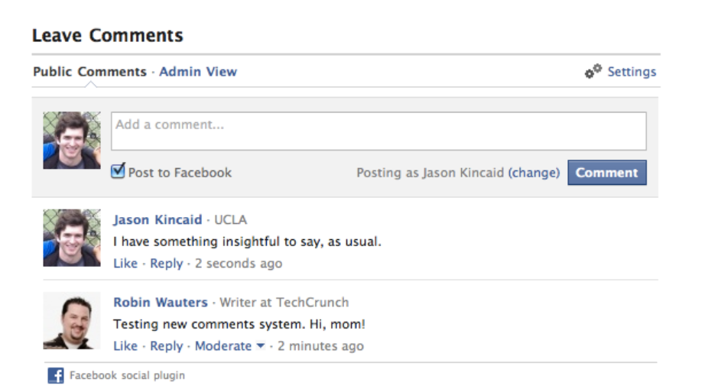
FITHUB
FEATURES
increasing the club's visibility in search engine results.
multi-language website and CRM, (Customer Relationship Management)
Website compliant with accessibility standards
facebook comment system
smart platform to handle communications smoothly
07

Slide 8
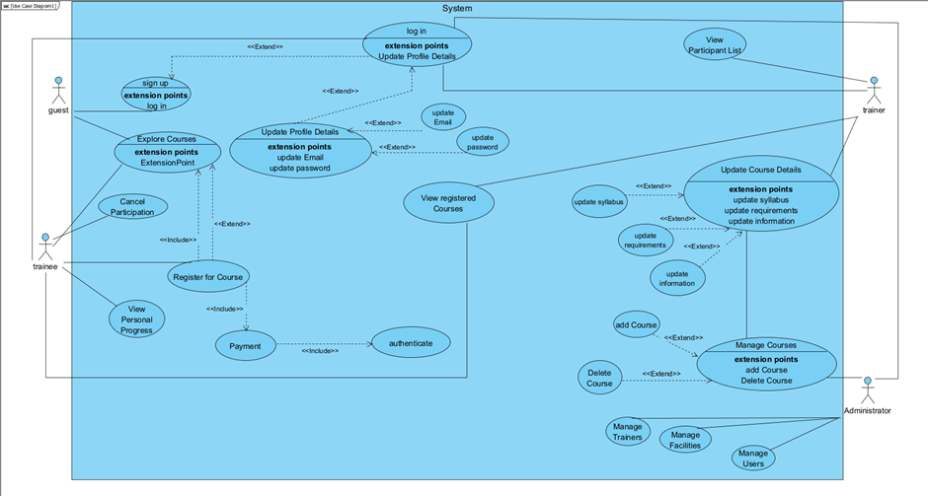
FITHUB
PRODUCT
USE CASE DIAGRAM
08
08

Slide 9
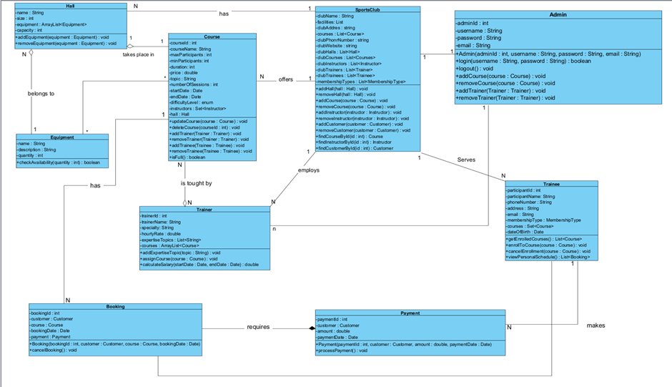
FITHUB
PRODUCT
CLASS DIAGRAM
09

Slide 10
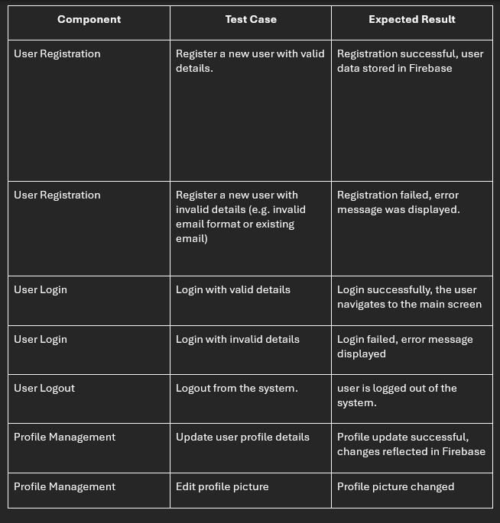
FITHUB
VERIICATIO-TESTING
UNIT TESTING
10

Slide 11
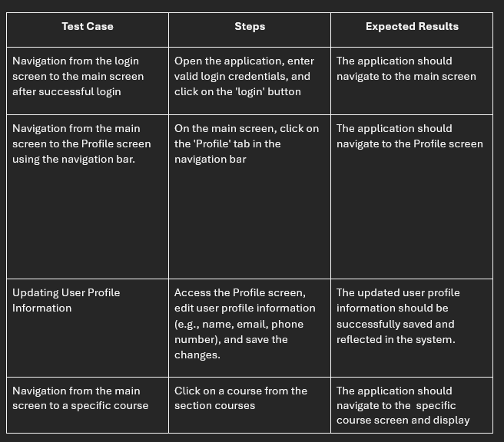
FITHUB
VERIICATIO-TESTING
MANUAL TESTING
11

Slide 12
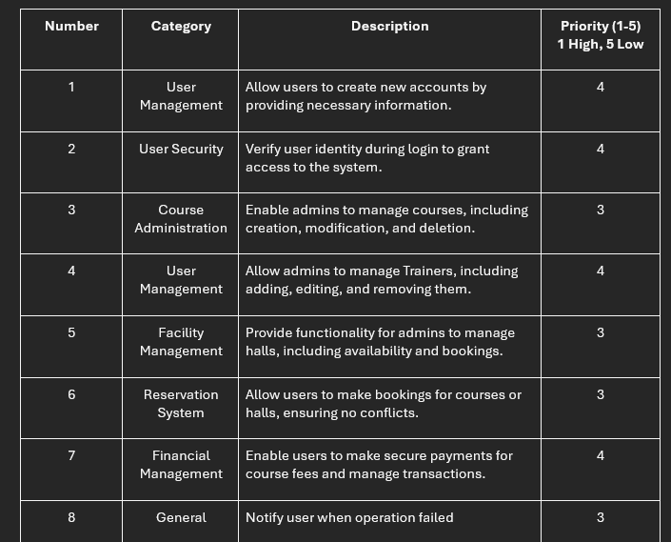
FITHUB
FUNCTIONAL REQUIREMENTS
12

Slide 13
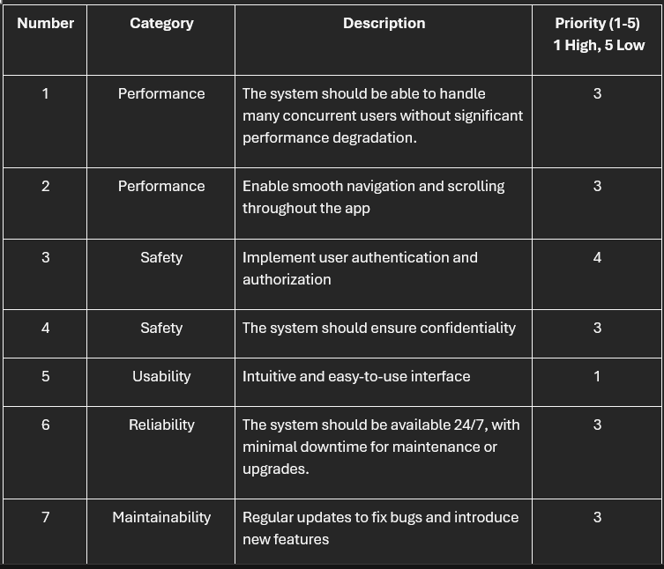
FITHUB
NON-FUNCTIONAL REQUIREMENTS
13

Slide 14
FITHUB
PROCESS CHALLENGES
Requirement Gathering and Analysis.
Planning the System.
Working Alone.
Testing.
14

Slide 15
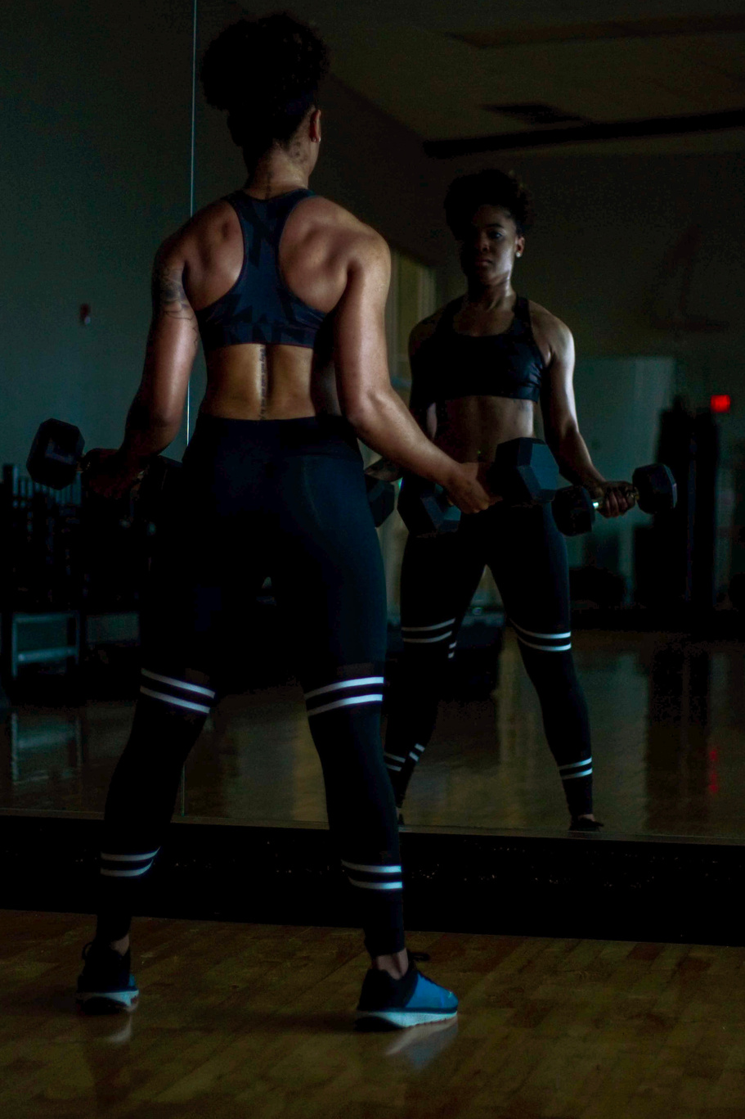
FITHUB
THANK YOU
"Empower your sports club with our innovative management system—where efficiency meets excellence."
SETTING YOU UP FOR SUCCESS
15

